Slide 1
How can Big Mountain Improve Profits?
A Data Science approach to discerning the key features of US Ski Resorts that drive profits

Slide 2
Problem Identification
How can Big Mountain Ski Resort Improve profits?
What key features currently drive Big Mountain’s profits?
What features can Big Mountain potentially divest from to save costs?
Does Big Mountian accurately price its tickets?
The data science approach can help answer the above questions

Slide 3
Limitations of the Dataset
Limitations of the above study / Important caveats:
The data and model formulated compared ski resort prices across the country, but most consumer preferences vs prices are localized, as in, consumers compare prices to resorts within their own state/city/local territory and not nationally. I think this consumer pricing behavior is a pivotal blindspot and improperly skews these studies.
Furthermore, as mentioned previously, a critical datapoint missing in these features is the number of visitors per day/year for each respective resort, especially as it relates to the overall population density within each resort.

Slide 4
Limitations Part 2
Other important missing features, include:
Average wait-time (especially for the most popular ski run of each resort, and the vertical drop of that specific run);
Average drive time/transportation time to the resort by its average consumer;
The respective demographics of each resort, including:
a. local vs out-of-state/city consumer. For instance, if its a resort that attracts out of state visitors, even across the nation, usually allows for the most premium pricing - ie. Aspen, Colorado.
b. Average income of consumers.
Brand value: Suppose a specific resort has a specific 'cachet' to consumers. Some resorts command premium pricing simply because of brand value.
Marketing/advertising: Do consumers in the area even know about the existence of the resort?
Newness of facilities: Self-explanatory.
Studies towards price elasticity of each price point etc
These studies generalize consumer preferences across the country, but perhaps localized preferences for each state etc sometimes differ dramatically from national preferences.
Many other potential ideas
Overall, these linear regressions produce an important initial 'skeleton' by which to model consumer preferences vs price, but further study is needed to unearth more granularity to these discoveries.

Slide 5
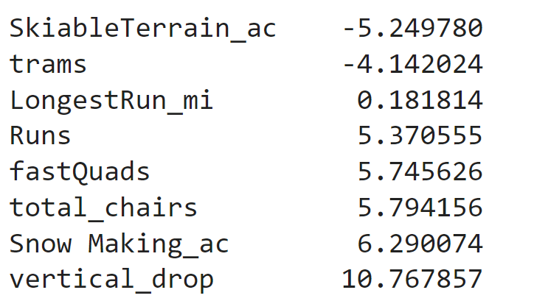
Model Analysis: Linear Regression Recommendations
Vertical Drop, Snow Making_ac, Total_chairs, and fastQuads are the top 4 priorities for a US Ski Resort

Slide 6
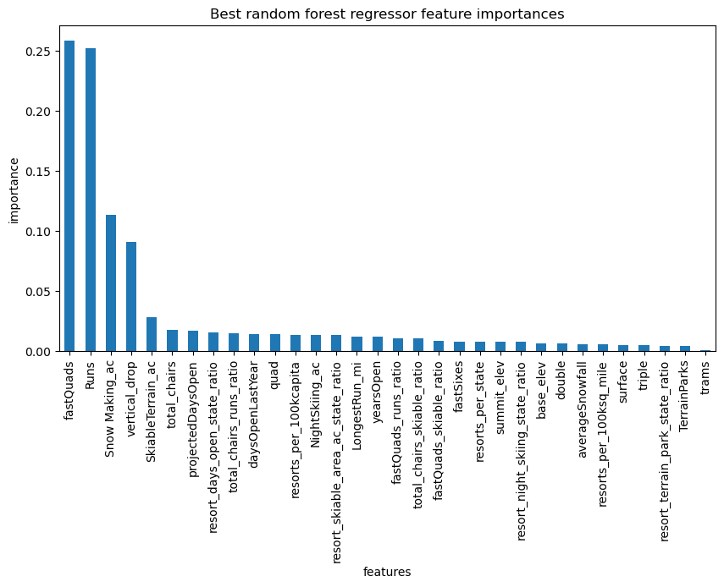
Model Analysis: Random Forest Recommendations
Fast Quads, Runs, Snow Making_ac, and Vertical Drop are the top 4 priorities for US Ski Resorts

Slide 7
Modeling Conclusion:
Although Linear Regression and Random Forest models do not output the same weights towards each respective Ski Resort feature, they both produce similar top critical features for Ski Resorts
The overlapping features are:
1. Fastquads
2. runs
3. Snowmaking_ac
4. Vertical Drop
These features should be highlighted going forth

Slide 8
Conclusion
In terms of the potential cost-savings vs investment options:
a. Already premium-priced: Big Mountain is already the highest-priced resort in the state by a wide-margin, despite not being top 1 in any of the critical features in the predictive model, except for (almost) snow-making ac. As discussed in the limitations section: Without further granularity towards local pricing dynamics, including the average net worth of Big Mountain’s consumers, it’s hard to discern whether Big Mountain can effectively raise ticket prices
b. Competitor analysis within the state: Having stated the above: futher studies should be conducted towards the features Big Mountain contains vs its closest competitors (this data is available). There are two close competitors to Big Mountain in the market segment directly beneath, and understanding how the business model and competitve advantages of those respective resorts will provide valuable insights into how Big Mountain is viewed by consumers, and what features command that price advantage for Big Mountain.
c. Without further exploration of wealth of average consumer vs ski resort pricing, I would exercise caution against raising the prices even more. Based on my cursory knowledge of Montana, I do not think the average income in that state is high, nor do residents out of state fly in for the ski resorts in that state.

